Slide 1
Guideline to the Management of COVID-19 in Pregnancy

Slide 2
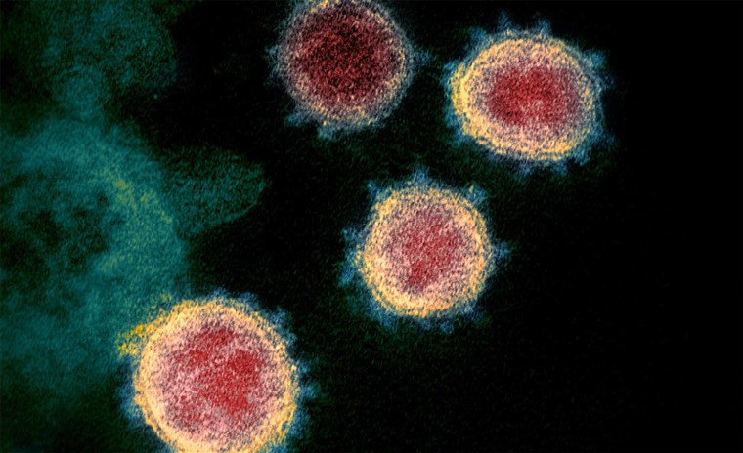
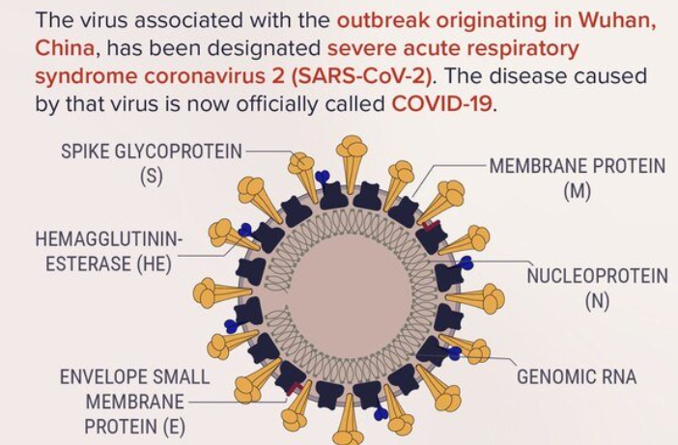
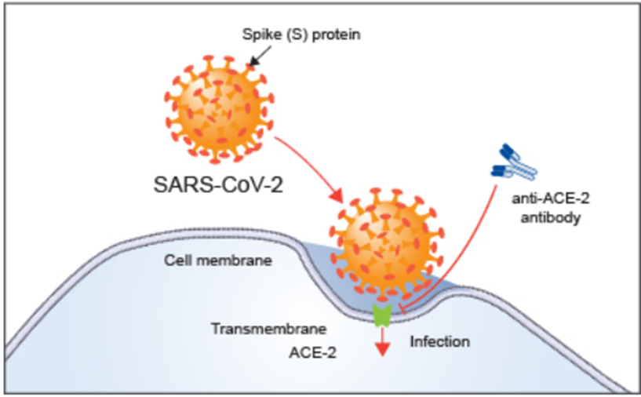
Understanding COVID-19
Coronaviruses: single-stranded RNA viruses that have a lipid envelope studded with club-shaped projections
COVID-19 virus binds to the ACE-2 receptor to enter the cell

Slide 3
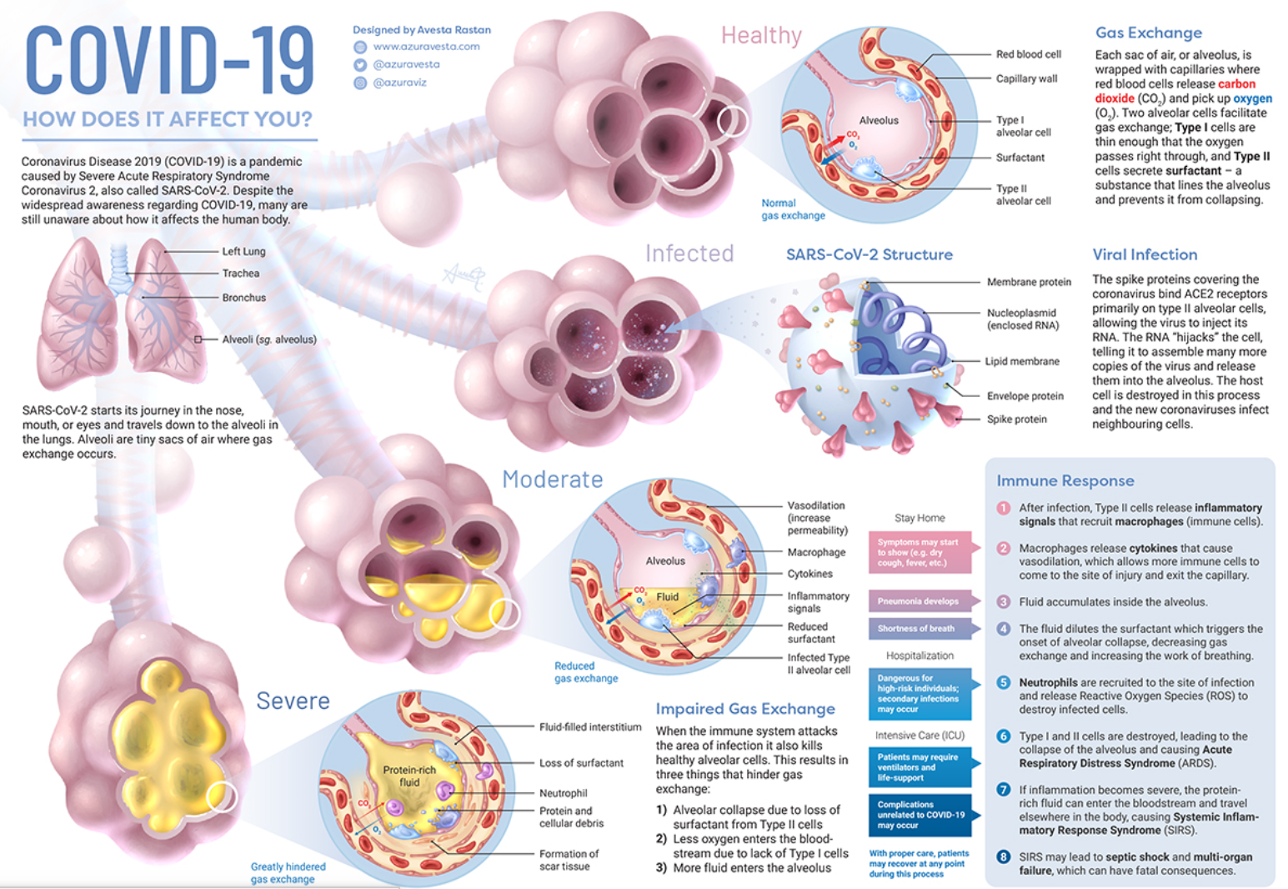
COVID-19 binds to type II pneumocyte
Uses cellular machinery to replicate
Ruptures host cell and releases virus to the alveolus
Immune response triggered
Virus attacks neighboring type II cells
Virus present in respiratory droplets/secretions

Slide 4
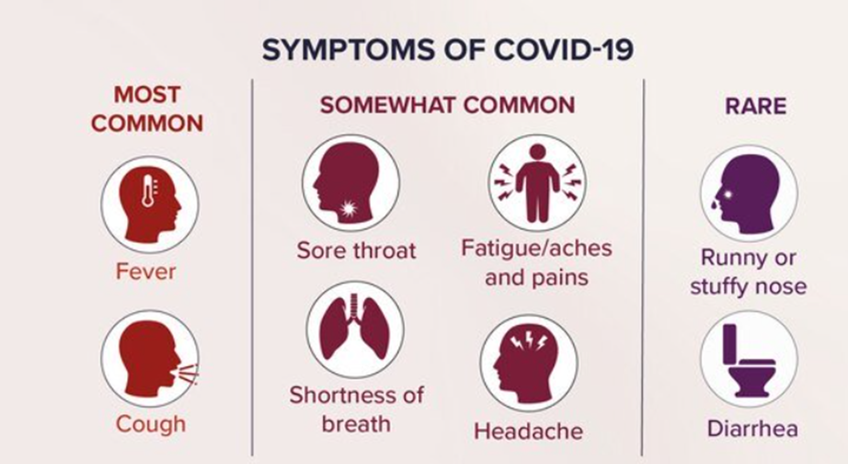
Clinical Presentation COVID-19 Infection
Primarily large droplet spread
Limited to respiratory droplets as no viremia
The mean incubation period = 5.2 days
Maximal incubation 14-21 days

Slide 5
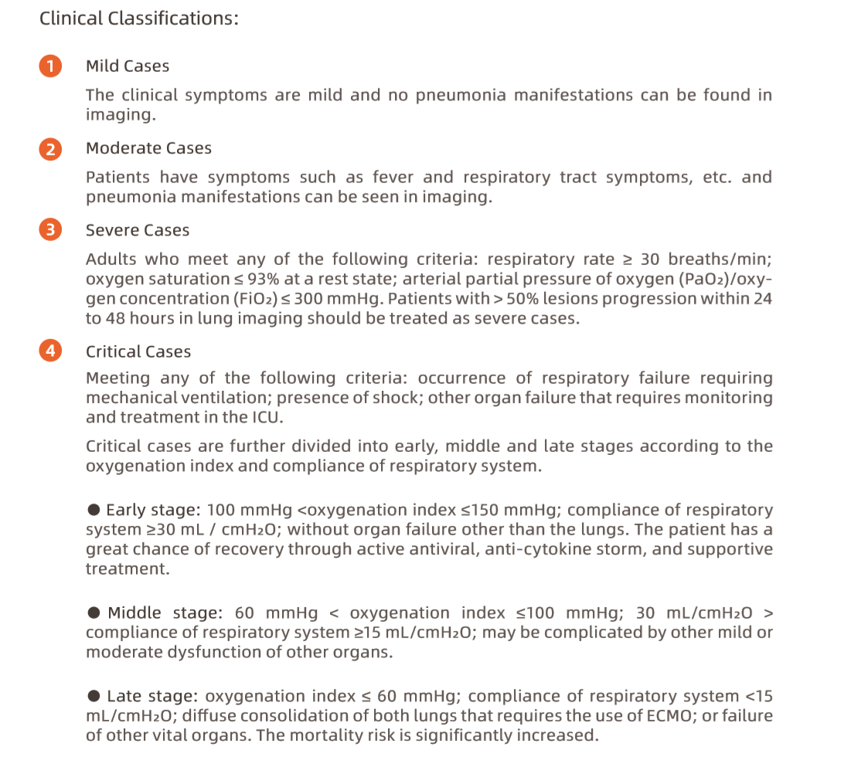
Defining the COVID Disease Spectrum
Upper respiratory infection * most common
Pneumonia
Increasing signs of respiratory distress
Respiratory Failure
Septic Shock
MSOF

Slide 6
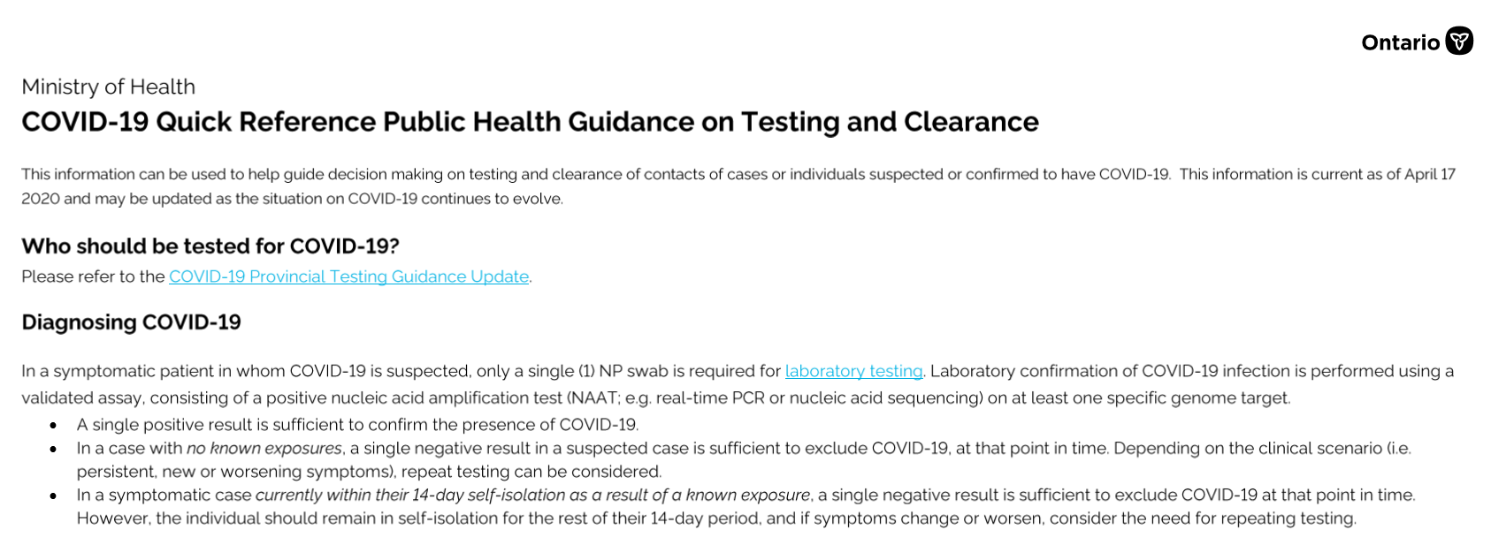
How do we diagnose COVID-19 infection
Screening questions about symptoms and contacts
*
Single NP swab for diagnosis in a symptomatic patient
2. Do not test asymptomatic patient

Slide 7
COVID Patient Description Language
COVID positive: Dx confirmed by NP swab
within 14d since symptoms started
COVID recovered: Dx confirmed by NP swab
after 14d since symptoms started; symptoms resolved x 24-48h
COVID PUI: Person under investigation
Symptomatic
NP swab taken and results pending
COVID negative: NP swab negative, asymptomatic
BUT !! If develops symptoms or the symptoms progress any time after taken… must be PUI
COVID unknown/
symptom free: Asymptomatic
No need for NP swab

Slide 8
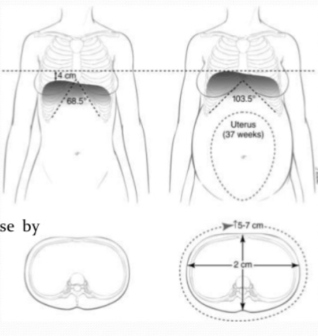
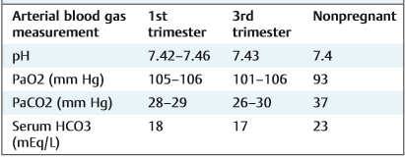
Respiratory Changes in Pregnancy & Potential COVID Impact
Less lung volume
Increased secretions
Increased minute ventilation
* Altered cellular immunity

Slide 9
COVID-19 and Pregnancy Key Points:
Pregnant women NOT more susceptible to COVID-19 infection
Most affected by COVID-19 make full recovery
15-20% develop a moderate to severe illness
Most common presentation of COVID-19 in pregnancy: fever > 37.8ºC, cough
Co-morbidity increases the risk of severe illness (DM, hypertension, PET, BMI, asthma, immunosuppression)
2 cases: COVID-19 induced coagulopathy in pregnancy
2 cases: COVID-19 induced cardiomyopathy in pregnancy (severe ill patients with pneumonia)
* viral induced cardiomyopathy: global hypokinesis, decreased L ejection fraction
2 cases: of maternal death (attributed to ARDS)
If COVID-19 + patient does deteriorate, typically day 7-9 after symptoms

Slide 10
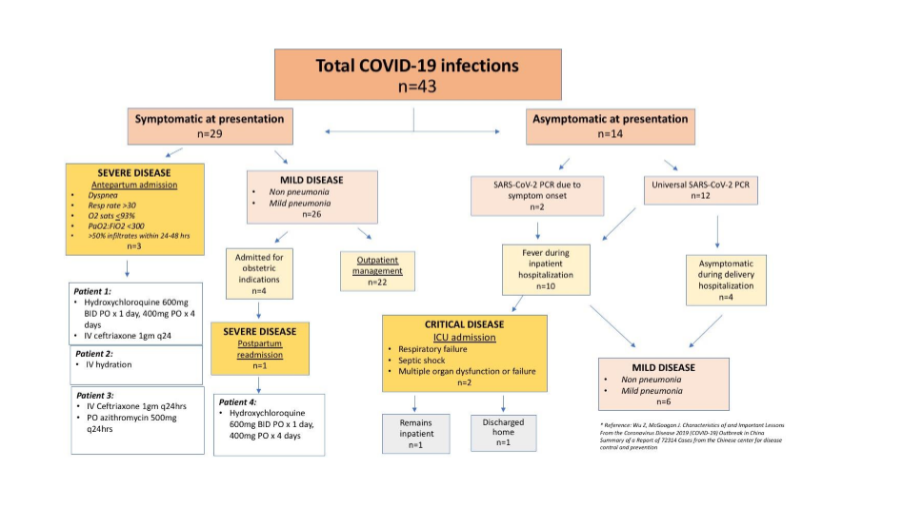
The prevalence of the disease in the community is high such that asymptomatic patients were detected with universal screening
This is the experience described in NYC: ~15-20% of pregnant women become critically ill
This mimics the reported experience in Italy, China, Netherlands

Slide 11
COVID-19 and Obstetrical Impact:
Majority of reported cases > 34w GA- mean GA 37w
Infection can occur at any gestational age (reported, local experience)
No data to suggest increased risk of T1/T2 SA or teratogenicity
Evidence suggest vertical transmission is possible (2 reported cases)
2 cases reported of PPROM; 1 case TPTL
Several cases of preterm birth: iatrogenic for maternal health concerns OR fetal health concerns.
1 case of IUFD reported: ?related to the critical illness of mother (mechanical ventilation/pneumonia)
3 cases of IUFD at term not reported – one associated with co-morbidity drug addiction

Slide 12
COVID-19 & Triage Assessment:
Patient presents to triage with COVID symptoms AND/OR an OBS concern:
Criteria for discharge home from triage:
Stable vital signs (HR < 100, RR 15-20, temp < 38oC, O2 sat > 94% on RA)
No oxygen requirement
No shortness of breath or work of breathing
Suitable for phone call follow up (through Public Health)
No acute obstetrical concerns
No other concerning co-morbidities
COVID Indications for admission: (based on illness assessment +/- co-morbidity)
Shortness of breath (unable to walk across room, speak full sentence)
Cough with blood
Chest pain
S/S dehydration
Decreased level of consciousness
Oxygen saturation < 94%
CXR consistent with pneumonia (ground glass opacities)

Slide 13
COVID-19 & Investigations:
Admission Investigations:
Baseline at admission, repeat as indicated
COVID NP swab
Routine bloodwork: lytes, creatinine, lactate
Prognostic bloodwork: CBC, PT, PTT, CRP, LDH, ferritin, fibrinogen, d-dimer (not to be used to detect risk of VTE as in non-pregnant population)
Lactate, Venous blood gas (if abnormal proceed to arterial blood gas)
BNP, troponin… if any concern for cardiac involvement
Urine PCR , uric acid +/- PLGF – if any concern for PET
Cultures: any concern for co-infections
ECG
CXR
2D ECHO (maternal) if severe illness/ICU admission/underlying cardiac condition
** if known cardiac disease consult with Cardiology to determine if should get an ECHO
CT scan only if clinically indicated (rule out pulmonary embolism)
* Consultation with ID , OB Medicine and ACCESS (ICU)

Slide 14
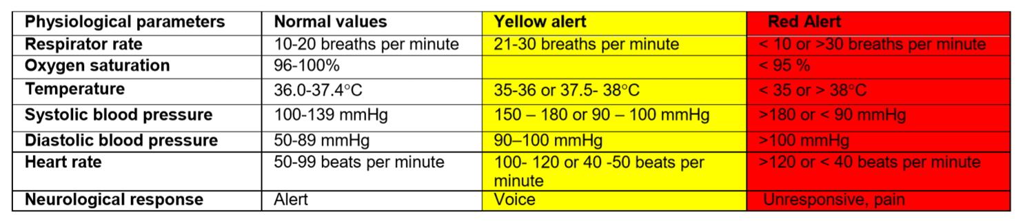
COVID-19 Admission and Surveillance:
Location depends on the local facility: Antenatal ward in level III centre Medicine ward in community setting
Surveillance & Warning signs
Vitals with O2 saturation q4h- if requiring oxygen support increase vitals to q hourly with 1:1 RN care
If requires: New use of oxygen support ** WARNING SIGN OF RESPIRATORY DETERIORATION: COVID SPECIFIC
RR increases despite normal O2 saturation
Increasing amount of oxygen to maintain saturation >94%
- Warning signs of maternal deterioration
Increased O2 demands by 50% over 1-2h
O2 sat < 94% despite O2 support
>4.0L O2 by facemask
Valid & Accurate & Applicable For Maternal Illness Assessment
High rate of detection (sensitive; true positive)
High negative predictive rate (specific; true negative)
Low rate of false positive (alert fatigue)
Tailored to the clinic setting, patient population
MEOWS: Maternal Early Obstetrical Warning Score
2 yellow or 1 red alert triggers MD evaluation

Slide 15
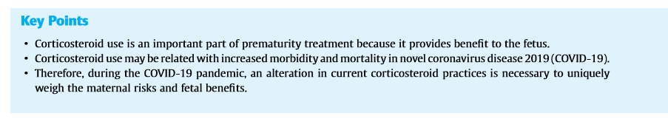
COVID-19 & Antenatal Management:
Role for thromboprophylaxis:
Any pregnant patient admitted to hospital for any indication is at risk for VTE
In COVID- “hypercoagulable” state
In GIM population, use of enoxaparin decreased mortality in patients with COVID severe illness
Recommend: VTE prophylaxis for pregnant patients admitted with moderate to severe disease COVID
- duration depends on clinical scenario
ie: moderate disease & delivered by C/S in patient with elevated BMI: duration based on OB recommendations
moderate disease admitted for COVID care & no other co-morbidities: duration of admission
Role for Celestone:
Corticosteroid Guidance for Pregnancy during COVID-19 Pandemic
Jennifer Jury McIntosh, DO, MD DOI https://doi.org/ 10.1055/s-0040-1709684.
lowest quality of evidence... authors opinion...
leap from high dose/duration in ICU patient
SUPPORT THE USE OF CELESTONE IF AN IDENTIFIED RISK FOR PRETERM BIRTH

Slide 16
COVID-19 & Antenatal Management:
Role of NSAIDS
NSAID use was suggested to worsen COVID illness
There is insufficient scientific evidence at this time to routinely avoid NSAIDs in patients with COVID-19
ASA for PET prophylaxis/based on abnormal placentation: - review the renal parameters (lytes and CR)
if no evidence of impairment likely continue risk PET > risk of ASA
if impaired, suspending ASA until recovery will likely no have a dramatic effect on PET/IUGR risk
Indomethacin for Tocolysis:
Given that no one tocolytic has proven benefit over another ..
May consider alternative choice, use clinical judgment
NSAID for postpartum pain management:
- May consider alternative choice(s)

Slide 17
Delivery Considerations with COVID-19
COVID-19 infection is NOT a direct indication for delivery
Decision to deliver is individualized based on maternal & fetal status, GA
Principles:
If < 28w GA & can maintain mechanical ventilation: Ext Mx ….. risk of prematurity > risk of IUFD
If <28w GA & can NOT maintain mechanical ventilation…. ? Would delivery improve ventilation status
If > 28w GA & can maintain mechanical ventilation …. Consider delivery if signs of non-reassuring fetal status*
If >28 w GA & CAN NOT maintain mechanical ventilation: …. Consider delivery to manage ventilation **
* Fetal monitoring will be abnormal: tachycardia, minimal variability… decide frequency & what criteria to act upon
** NOT to improve maternal disease process, not to alter fetal/neonatal outcome, but to facilitate the ventilation
*** if delivering < 34w GA, give MgSO4 4g bolus before delivery- over 1 hour to limit maternal respiratory depression

Slide 18
Key Points for Fever/Symptoms in Routine Antenatal Patient
All patients admitted to antenatal unit are screened at entry and daily q shift (with vitals)
ANY PATIENT could develop COVID-19 symptoms/infection…….
IF a COVID screen negative patient develops:
Temperature >37.8ºC (most common symptom in pregnancy) or any other symptoms
Give 500 cc fluid bolus (takes 30 min)
Repeat temperature 30 min after bolus completed
If still >37.8 (or any other symptoms) ….
NP swab for COVID-19
Initiate Droplet /Contact Precautions
Order investigations as appropriate based on symptomatology/ co-morbidity
Increase maternal surveillance to vital signs with O2 saturation q4h
If NP swab positive, room mate is now a contact- needs Isolation & Droplet/Contact Precautions

Slide 19
COVID-19 and Intrapartum Management: Key Points
Regardless of GA and disease severity: recommend hospital birth
Regardless of GA: CEFM based on case reports of fetal compromise in women with COVID-19 diagnosis (8/18 – 44% incidence)
If mild symptoms: Maternal vital signs (HR, BP, RR, O2 sat) q 2h.
If moderate symptoms: Maternal vital signs (HR, BP, RR, O2 sat) q 1h. Oxygen to keep O2 sat >94%
Hourly fluid status to avoid fluid overload (affects ventilation, work of breathing)
No hydrotherapy in labor/birth (risk of virus in feces? Infectious)
Encourage epidural anesthesia: minimize risk for GA
No evidence of virus in vaginal secretions/amniotic fluid: use Fetal Scalp Electrode and Scalp lactate sampling as per OB indications
No use of nitrous oxide for pain management (potential aersolization)
No indication for C/S unless to improve maternal resuscitation efforts
Emergent C/S for OB indications not because of COVID diagnosis
Elective C/S should not be delayed based on COVID diagnosis unless need for maternal stabilization.
COVID diagnosis is not an indication for IOL; diagnosis of COVID is not a reason to delay an indication/urgent IOL unless need for maternal stabilization.
Consideration: If SOB, maternal exhaustion or increasing hypoxia: may use assisted vaginal birth to shorten the second stage

Slide 20
Key Points for Fever in Labor
Temperature >37.8oC
Give 500 cc fluid bolus (takes 30 min). DO NOT GIVE TYELENOL DURING THIS TIME
Repeat temperature 30 min after bolus completed
If still >37.8 (or any other symptoms) ….
Patient is now a PUI
NP swab for COVID
Initiate Droplet /Contact Precautions
IF > 38ºC … initiate chorioamnionitis workup and treatment … Blood cultures, Tyelenol, Broad spectrum ABX
After birth- Neonate also a PUI: perform NP swab
** Note: if using Misoprostil use for term IOL:
- 25-50 μg dose for IOL will not give maternal temperature

Slide 21
Key Points for TOP: Antenatal Unit or L&D
Patient is screened at entry &
again on admission (with maternal temp check)
Screen negative (asymptomatic)
Proceed to IOL
1st dose of misoprostil with Tyelenol (1g) po
Dose misoprostil q 4h
Dose Tyelenol q6h (standing, regardless of maternal temp)
If temp > 37.8oC:
bolus 500cc over 30 min
Recheck temp 30 min after bolus complete
If remains >37.8oC… patient is now a PUI
NP swab and Droplet/Contact Precautions
Screen positive (symptomatic).. Patient is a PUI
NP Swab and Droplet/ Contact Precaution
1st dose of misoprostil + Tyelenol (1g) po
Dose misoprostil q 4h
Dose Tyelenol q6h (standing, regardless of maternal temp)
* Can substitute ASA (325mg) if allergy

Slide 22
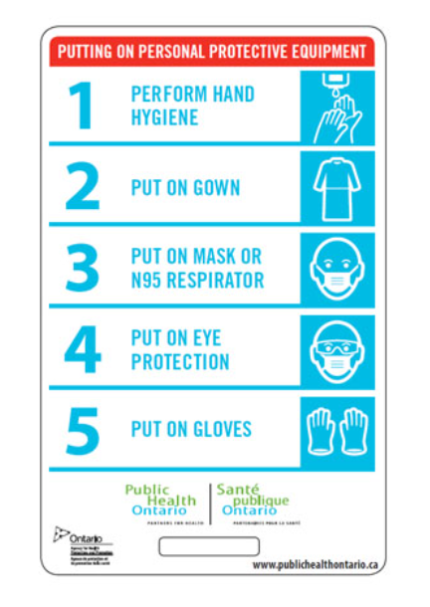
COVID: Donning and Doffing PPE:
DONNING PROCESS
This order suggested by Public Health does not account for the need for the surgical scrub for a C/S
This is a series of videos to guide OBs for DON and DOFF based on our unique patient interactions. This videos are based at Sinai Health System but do provide guidance for principles
Remember to DON outside the patient room/OR: in a clean space
If have a negative pressure room: the anteroom considered contaminated –
Don outside the room/OR

Slide 23
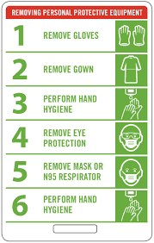
COVID: Donning and Doffing PPE:
DOFFING PROCESS
This order suggested by Public Health does not account for the need for the extra protective gear an OB would wear at a delivery
Principle of Doffing: dirtiest to cleanest
After a delivery:
Removes shoe covers
May consider to untie dirty gown with gloves on and then remove gown – gloves often pull off with the gown
Remember to DOFF inside the patient room/OR: EXCEPT MASK
DOFF Mask outside the patient room/OR
* If have negative pressure room DOFF all PPE in the anteroom

Slide 24
UNIVERSAL PRECAUTIONS FOR ANY NON-COVID BIRTH:
This is the Universal standard of Personal Protection Equipment at a Birth: not COVID +/PUI !!!
Goal is to protect against any pathogen contamination at a birth:
SHOES COVERS
WATER IMPERMEABLE GOWN
HAT (MAY USE OWN FABRIC CAP)
MASK
EYE PROTECTION (MAY USE OWN GOGGLES)
STERILE GLOVES
In the OR at a C/S, the glove and gowns will be donned using sterile technique after the scrub
In an LDR, the donning and doffing can occur in the room*

Slide 25
Key Points for Newborn to COVID +/PUI mom:
Based on: No evidence of virus in cord blood
Fetus was exposed to cord blood
Limited evidence of vertical transmission
Support breastfeeding*
Support skin to skin
Any direct baby care
* https://www.cps.ca/en/documents/position/breastfeeding-when-mothers-have-suspected-or-proven-covid-19
SUPPPORT DELAYED CORD CLAMPING
Mother to wear mask

Slide 26
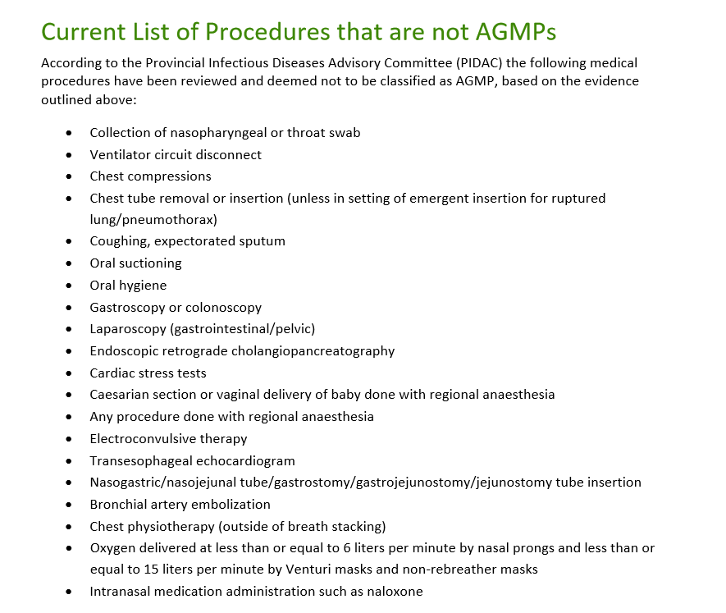
We are choosing to wear N95 Mask at birth because of the POTENTIAL for bag/mask &/or of the newborn
Public Health Ontario 2020

Slide 27
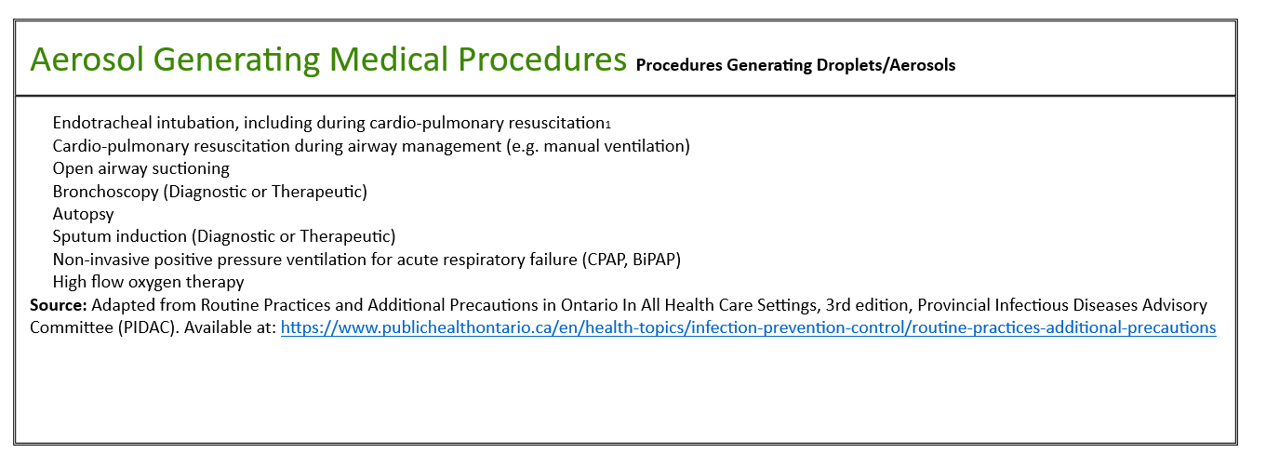
Procedures for which an N95 Mask should be worn

Slide 28
Note: for Anesthesia Team
UNIVERSAL PRECAUTIONS FOR ANY AGMP
This is the Universal standard of Personal Protection Equipment at an AGMP: not COVID +/PUI !!!
Goal is to protect against any pathogen contamination at a intubation:
GOWN
HAT (MAY USE OWN FABRIC CAP)
N95 MASK
EYE PROTECTION (face shield/ goggles)
GLOVES
** there will be clinical situations where the anesthesia team will have an N95 mask applied BUT OB and RN do not require an N95 mask
In any patient, regardless of COVID-19 status, intubation/extubation is an AGMP and places the anesthetist at risk of contamination by any airway pathogen as they are in direct contact with airway aerosol.
As such, best practice dictates that the members of the anesthesia team take Droplet/Contact Precautions + N95 respirator for the intubation/extubation.
Other members of the OR team are not in direct contact with airway aerosol and do not require an N95 respirator.
Members of OR team may chose to step out of the OR during the intubation/extubation.

Slide 29
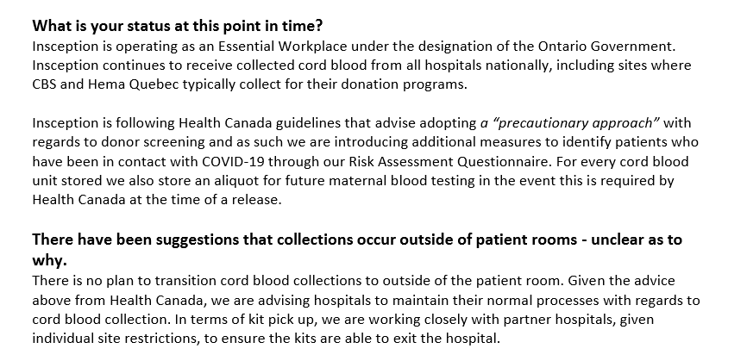
Patient Driven Stem Cell Collection
At the patient discretion
Take sample for maternal COVID testing
Routine practice

Slide 30
COVID-19 & Postpartum Management: Key Points
WHEN TRANSPORTING TO MBU: COVID +/PUI: mother to wear mask, baby in an isolette
Supportive care: oxygen, anti-pyrexia medication
No relapse of symptoms was found after delivery
Consider alternative choice to NSAID post-partum pain management
Thromboporphylaxis:
- based on OB indications (SOGC 2014 guideline)
- if no OB indication, recommend if moderate to severe COVID disease
If admitted for birth without symptoms:
monitor for s/s COVID as may develop symptoms during hospitalization
recall: incubation period mean 5-6d (0-14d)
new onset respiratory s/s OR fever > 37.8oC.
Safe for discharge if clinically well. Instruct to continue to quarantine for 14 days after onset of symptoms
No need for repeat COVID testing.

Slide 31
Key Points for Fever/Symptoms in Post-partum Patient
ANY PATIENT admitted to the Post Partum Unit could develop COVID-19 symptoms/infection
IF a COVID screen negative patient develops:
Temperature >37.8ºC (most common symptom of COVID) or any other symptoms
Give 500 cc fluid bolus (takes 30 min)
Repeat temperature 30 min after bolus completed
If still >37.8º (or any other symptoms) ….
NP swab for COVID-19
Initiate Droplet /Contact Precautions
Order investigations as appropriate based on symptomatology/ co-morbidity
Increase maternal surveillance to vital signs with O2 saturation q4h
If NP swab positive, room mate is now a contact- needs Isolation & Droplet/Contact Precautions
If NP swab positive: baby needs NP swab

Slide 32
Key Points for Newborn to COVID +/PUI mom:
Based on: No evidence of virus in cord blood
Fetus was exposed to cord blood
Limited evidence of vertical transmission
Support breastfeeding*
Support skin to skin
Any direct baby care
* https://www.cps.ca/en/documents/position/breastfeeding-when-mothers-have-suspected-or-proven-covid-19
SUPPPORT DELAYED CORD CLAMPING
Mother to wear mask

Slide 33
COVID-19 Recovery Algorithm
1. COVID diagnosis confirmed. Stays as an outpatient. Performs 14d self-isolation. Now has no symptoms consider COVID recovered. Does not need a swab for "test of cure". Can come back into medical system as COVID recovered/not infectious/negative.
2. COVID diagnosis confirmed, admitted for COVID support but then discharged before the 14d completed. Complete 14d self-isolation. Now has no symptoms, consider COVID recovered. Does not need a swab for "test of cure". Can come back into medical system as COVID recovered/not infectious/negative.
3. COVID diagnosis confirmed, admitted for COVID support and/or OB indication and is NOT discharged. At day 14 and with no symptoms we should perform 2 sets of NP swabs separated by 24h- both need to be negative and then she will be clear and released from droplet precaution (as per IPAC at MSH) Then she will be treated by us as COVID recovered/not infectious/negative.
*** If still antepartum: Ongoing fetal surveillance within 14d of discharge: BPP with Doppler and EFW

Slide 34
Having a baby after COVID infection !
In the current state:
Screening at hospital entry
Screened with maternal temp in OB triage / labor
Treat as any screen negative patient
No “special precautions” for Labor & Delivery unless indicated by screening
5. Use universal precautions with the delivery:
OB provider: surgical mask, hat, eye protection, gloves and gown, shoe covers
Anesthesia: surgical mask, eye protection, gloves, gown and N95 mask if she requires intubation
RN: surgical mask, hat, eye protection, gloves and gown, shoe covers
6. Baby will NOT have an NP swab.
7. Mother & partner will NOT mask when having contact with baby (Skin to skin, BF...).

Slide 35
COVID-19 & Pregnancy Key Points for Patient Counselling:
- Pregnant patients affected by COVID-19 make full recovery
15-20% develop a moderate to severe illness (2 case reports of maternal death; social media reports …)
No data to suggest increased risk of T1/T2 SA or teratogenicity
Limited evidence suggest vertical transmission is possible: to date babies born to COVID + moms have been well
Limited evidence suggests no increased risk of spontaneous preterm birth (labor)
Several cases of preterm birth: indicated for maternal health concerns OR fetal health concerns.
No data to suggest increased risk of IUFD
Based on data from SARS and MERS and other respiratory infection in pregnancy:
- minimal effect on long-term fetal growth/wellbeing
- suggest F/U OB scan once recovered

